Slide 1
X Education - Lead Scoring Case Study
Increasing lead conversion rate for X education
Group Members:
Gagan Preet Singh
Surendra Singh Mehta

Slide 2
Background
X Education , An education company named sells online courses to industry professionals
Many interested professionals land on their website
The company markets its courses on several websites like Google. Once these people land on the website, they might browse the courses or fill up a form for the course or watch some videos
When these people fill up a form providing their email address or phone number, they are classified to be a lead
Once these leads are acquired, employees from the sales team start making calls, writing emails, etc. Through this process, some of the leads get converted while most do not
The typical lead conversion rate at X education is around 30%
X Education Company

Slide 3
Problem Statement
X Education gets a lot of leads but its lead conversion rate is very poor
To make this process more efficient, the company wishes to identify the most potential leads, also known as ‘Hot Leads’
If they successfully identify this set of leads, the lead conversion rate should go up as the sales team will now be focusing more on communicating with the potential leads rather than making calls to everyone
We will help them to select the most promising leads, i.e. the leads that are most likely to convert into paying customers.
We are required to build a model wherein we need to assign a lead score to each of the leads such that the customers with higher lead score have a higher conversion chance
The CEO, in particular, has given a ballpark of the target lead conversion rate to be 80%.
X Education Company’s Problem

Slide 4
Lead – Conversion Process
Lead Generation:
1. Ads on websites like Google
2. Referrals
Visit to X Education website by these potential customers (professionals)
Visitors either provide Email id & Contact Details
Or
View videos etc
Tele calling and Emailing activity to all the leads
~30% leads get converted
Lead to Conversion process
Proposed Solution:
A model to filter leads so that leads to conversion ratio is 80%+

Slide 5
Solution
For our Problem Solution, the crucial part is to accurately identify hot leads.
The more accurate we obtain the hot lead, the more chance we get of higher conversion ratio.
Since we have a target of 80% conversion rate, we would want to obtain a high accuracy in obtaining hot leads.
Selection of Hot Leads

Slide 6
EDA- Visualization

Slide 7
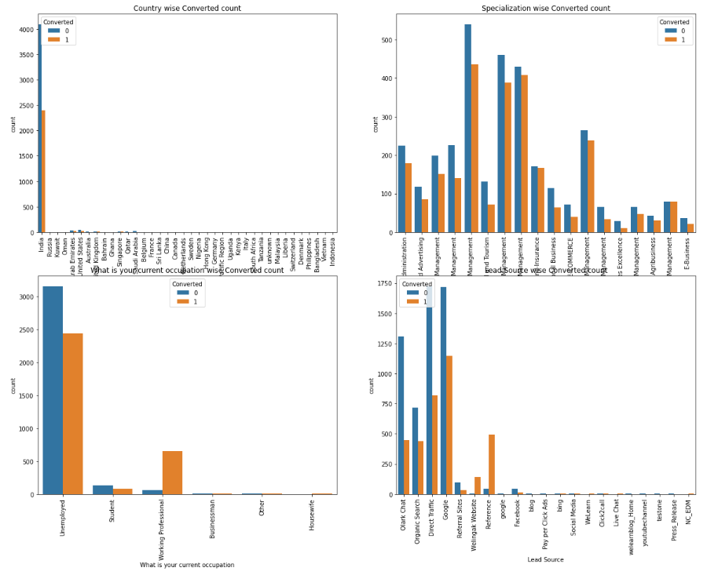
India is the top source of student and target working professional or unemployment.

Slide 8
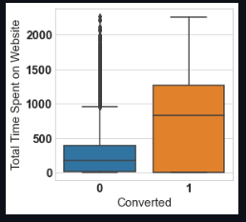
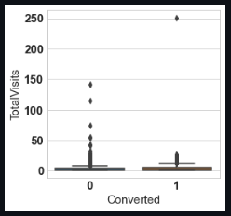
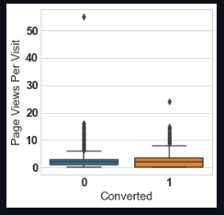
EDA plots depicting variation in numerical columns for those who Converted and those who didn't.

Slide 9
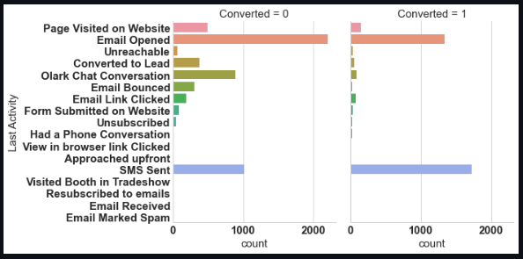
EDA plots depicting variation in categorical column (Last Activity) for those who Converted and those who didn't.

Slide 10
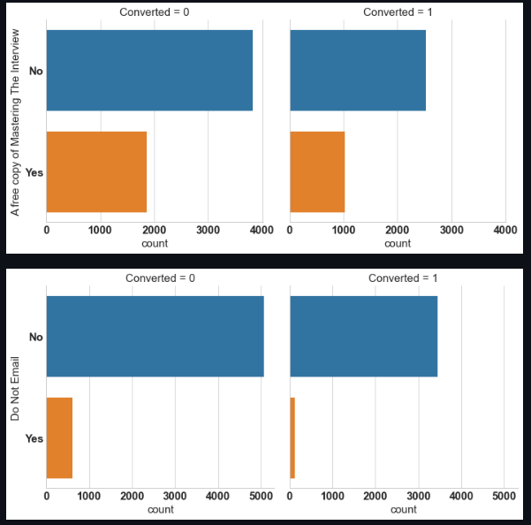
Variation in categorical column (A free copy of Mastering The Interview and Do not email) for those who Converted and those who didn't.

Slide 11
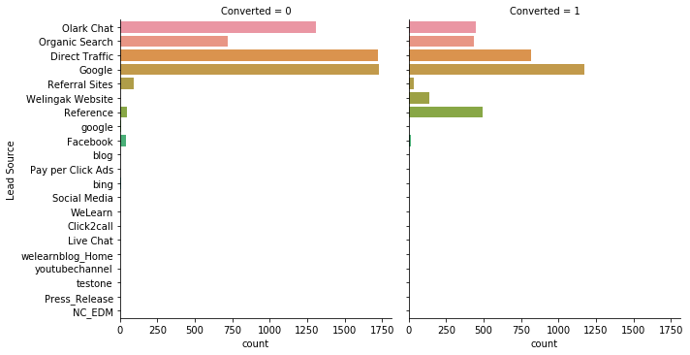
EDA plots depicting variation in categorical column (Lead Source) for those who Converted and those who didn't.

Slide 12
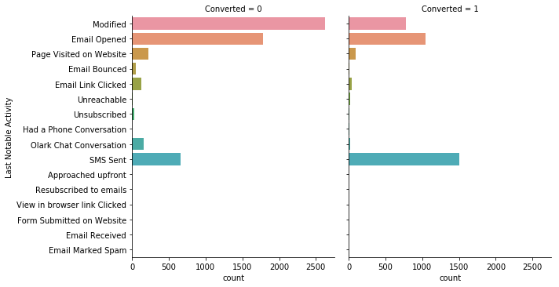
EDA plots depicting variation in categorical column (Last Notable Activity) for those who Converted and those who didn't.

Slide 13
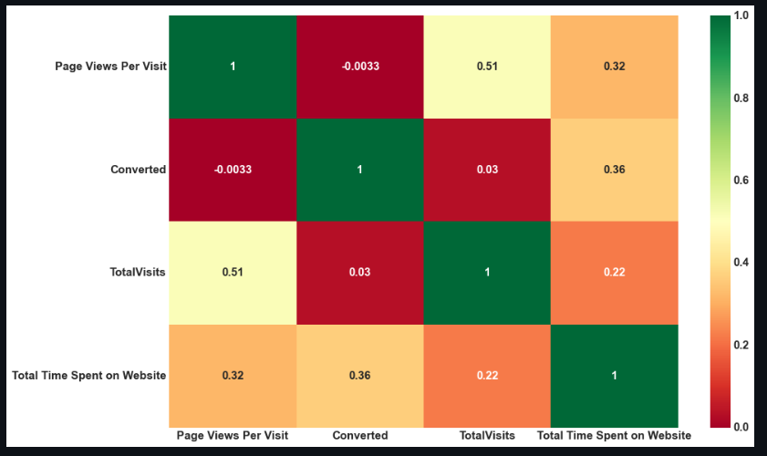
EDA plots depicting correlation (Heat Map) of all selected numerical columns.

Slide 14
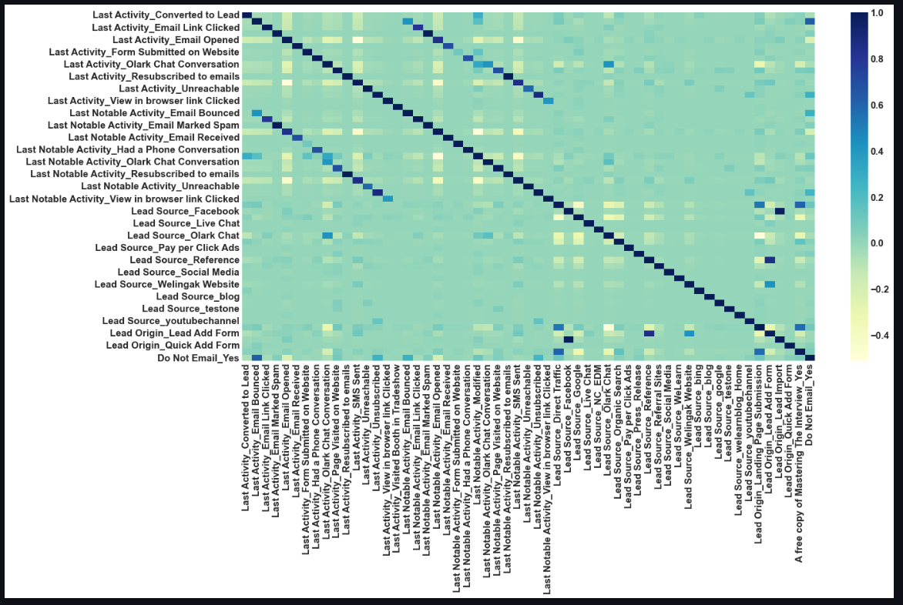
EDA plots depicting correlation (Heat Map) of all selected columns (numerical columns and dummy columns).

Slide 15
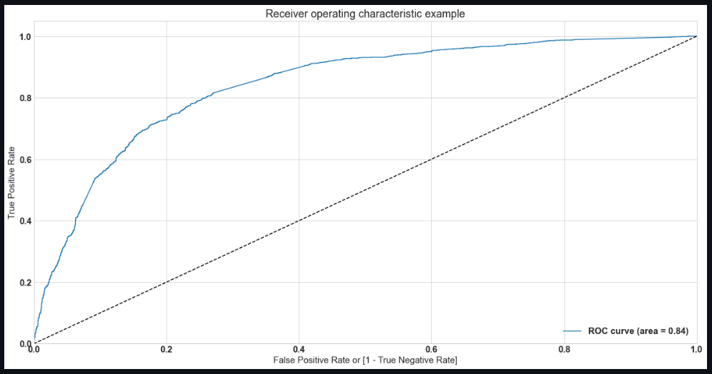
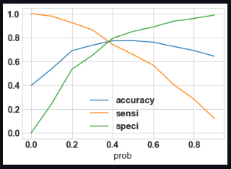
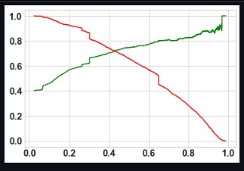
Linear Regression Final Model Parameters
Area under ROC = 0.84
Intermediate cut-off = 0.35
Final cut-off = 0.42

Slide 16
Inference / Conclusion

Slide 17
Model Analysis
Overall accuracy on Test set: 0.76
Sensitivity of our logistic regression model: 0.73
Specificity of our logistic regression model: 0.81
Performance of our Final Model

Slide 18
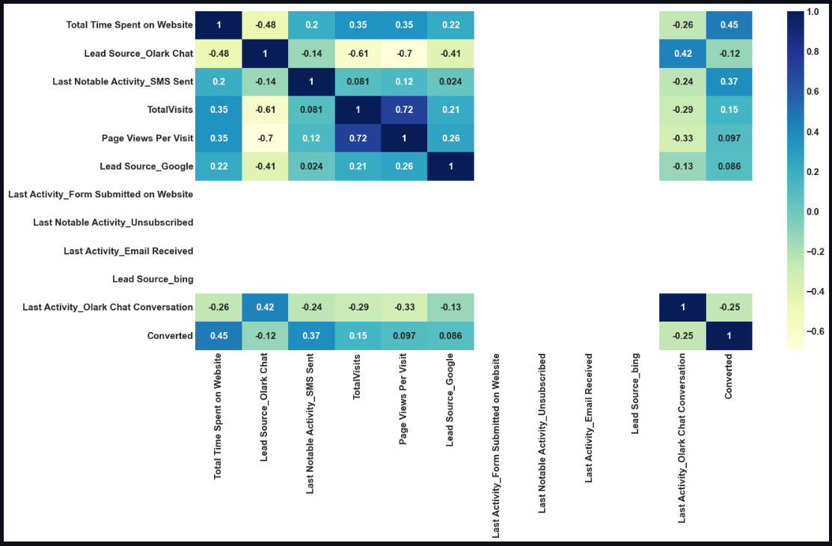
Correlation Between Model selected indicators

Slide 19
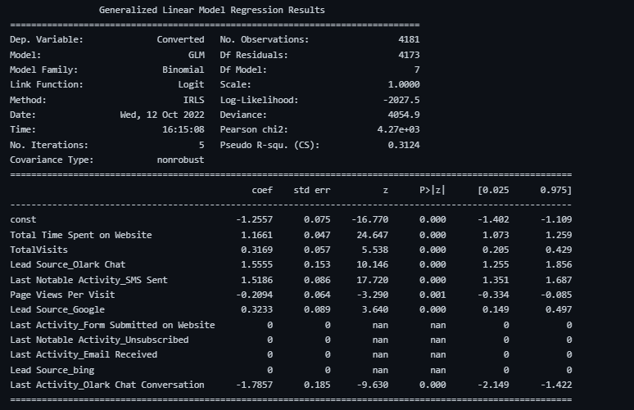
Screenshot of Final Model and Coef. , P value and other stats.

Slide 20
Conclusion (Recommendation)
X Education Company needs to focus on following key aspects to improve the overall conversion rate:
Increase user engagement on your website as this helps in higher conversion.
Get Total visits increased by advertising etc.
Increase on sending SMS notifications
Improve the Olark Chat servic

Slide 21
Thank-you

